Slide 1
Chapter 9
Basic Concepts of Probability

Slide 2
Learning Outcomes
When you will complete this chapter, you would be able to-
Basic terms and content of probability
Calculate probability between two events
Estimate and interpret different types of rules of probability
Identify the relation and different types of probability
Identify the relation and different types of probability with practical examples

Slide 3
Lecture Contents
Basic Terminology of Probability
Different Approaches of Probability
Application and Significance of Probability
Laws of Probability
Probability Rules
Joint, Marginal and Conditional Probability
Various Mathematical Problems of Probability

Slide 4
Basic Terminology of Probability
Probability: A value between zero and one, inclusive, describing the relative possibility (chance or likelihood) an event will occur.
Experiment: Experiment is an act that can be repeated under given conditions.
Trial: Unit of an experiment is known as trial. This means that trial is a special case of experiment. Experiment may be a trial or two or more trials.
Outcomes: The result of an experiment is known as outcomes.
Example: Throwing a die is a trial and getting 1 or 2 or 3 or 4 or 5 or 6 is an outcome.
Equally likely Outcomes: Outcomes of a trial are said to be equally likely if we have no reason to expect any one rather than the other. Example-1) In tossing a fair coin, the outcomes head and tail are equally likely, 2) In throwing a balanced die all the six faces are equally likely.

Slide 5
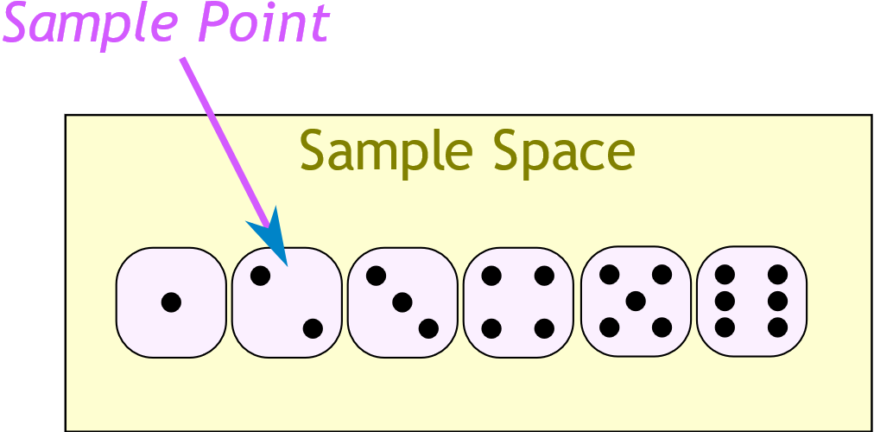
Basic Terminology of Probability
Mutually Exclusive Outcomes: Outcomes or cases are said to be mutually exclusive if the happening of any one of them precludes the happening of all others. Example-1) In tossing a coin, the outcomes hear and tail are mutually exclusive.2) In throwing a die, the six outcomes which are the different points on the faces of the die is mutually exclusive.
Exhaustive outcomes: Outcomes of an experiment are said to be exhaustive if they include all possible outcomes. Example-in throwing a die exhaustive number of outcomes are 6.
Sample space: The collection of all possible outcomes of a random experiment is called sample space. Sample space is usually denoted by S or Ω . Example:1) If we toss a coin, the sample space is, Ω ={H,T}.
Where H and T denote the hear and tail of the coin, respectively, 2)If a six–sided die is thrown, the sample space is, Ω ={1,2,3,4,5,6}.

Slide 6
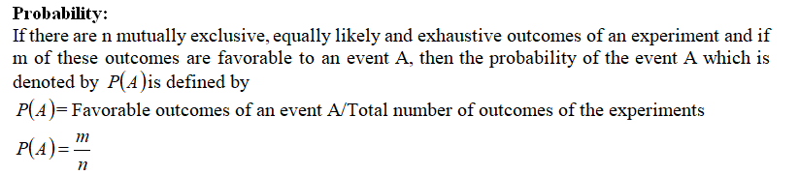
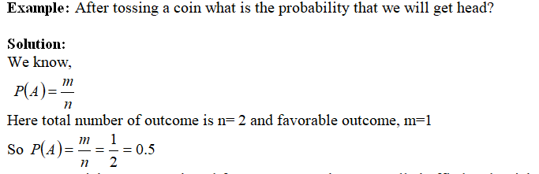
Probability

Slide 7
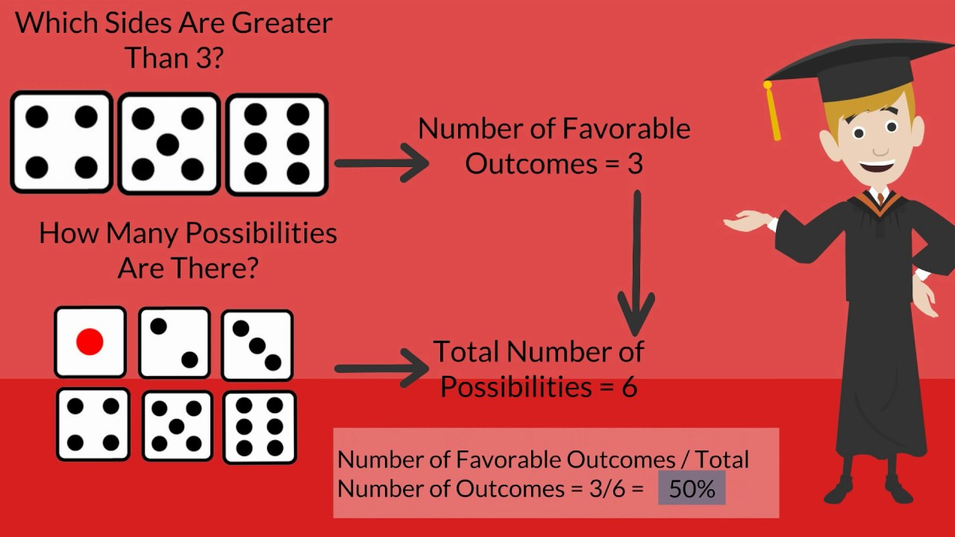
Probability

Slide 8
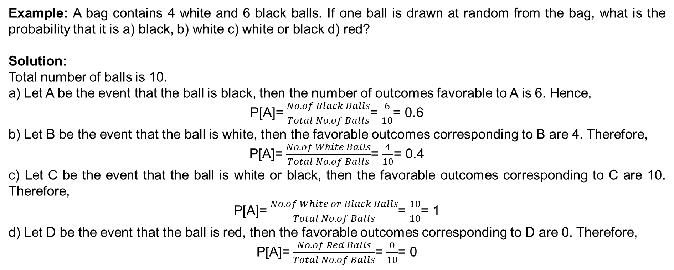
Probability

Slide 9
Application and Significance of Probability
Probability is the backbone of statistics. It has vast application in every field of statistics. The various practical applications of the probability are:
In statistical inference, the problem of estimation and the test of hypothesis are based on probability theory.
The various test of significance, viz- Z-test, Chi-square test, F- test, t- test are derived from the theory of probability.
c) Decision theories are based on fundamental laws of probability and expected value.
d) The use of probability theory is increasing in economic decision making.
e) The use of subjective probabilities is made when actual measurement is not possible.

Slide 10
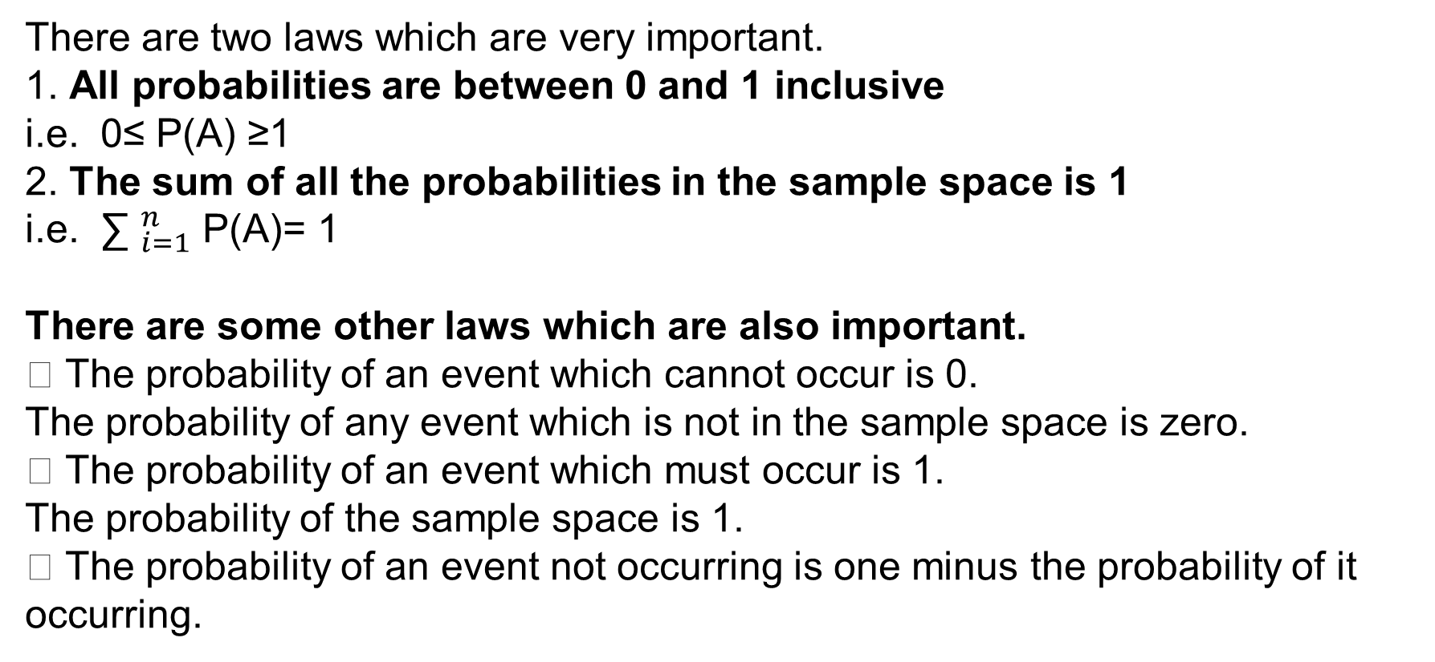
Laws of Probability

Slide 11
Addition Rules
Additive Law of Probability: There are two rules of addition, the special rule of addition and the general rule of addition.
Special Rule of Addition: To apply the special rule of addition, the events must be mutually exclusive. If two events A and B are mutually exclusive, the special rule of addition states that the probability of one or the other event’s occurring equals the sum of their probabilities. This rule is expressed in the following formula:
P(A or B)= P(A U B)= P(A) + P(B)
General Rule of Addition: When two events both occur, the probability is called a joint probability. In this situation, we use the general rule of addition. If A and B are two events in , then
P(A or B)= P(A U B)= P(A) + P(B) – P(A∩B)

Slide 12
Addition Rules
Example: Mr. Ali feels that the probability that he will pass mathematics is 2/3 and statistics is 5/6.If the probability that he will pass both the course is 3/5, what is the probability that he will pass at least one of the course?
Solution: Let M and S be the events that he will pass the course mathematics and statistics, respectively. The event M U S means that at least one of M or S occurs. Therefore, according to the addition rule we get,
P(A or B)= P(A U B)= P(A) + P(B) – P(A∩B)
= 2/3 + 5/6 – 3/5
= 9/10

Slide 13
Addition Rules
Example:
In a sample of 500 students, 320 said they had a stereo, 175 said they had a TV, and 100 said they had both. 5 said they had neither. If a student is selected at random, what is the probability that the student has only a stereo or TV? What is the probability that the student has both a stereo and TV?
Solution: Let S and T be the events that students had stereo and TV, respectively. Then the probability that student has only stereo or TV is-
P (S or T) = P(S) + P (T) – P (S and T)
= 320/500 + 175/500 – 100/500
= 0.79
The probability that the student has both a stereo and TV:
P (S and TV) = 100/500
= 0.20

Slide 14
Joint Probability
Joint probability is the probability of two events in conjunction. That is, it is the probability of both events together. The joint probability of A and B is written P (A∩B), P(AB) or P(A,B).
Example: The question, "Do you like watching TV?" was asked of 100 people. Results are shown in the table. What is the probability of a randomly selected individual being a male who likes watching TV?
 | Yes | No | Total
Male | 19 | 41 | 60
Female | 12 | 28 | 40
Total | 31 | 69 | 100
Solution: This is just a joint probability. The number of "Male and like watching TV" divided by the total = 19/100 = 0.19

Slide 15
Marginal Probability
Marginal probability is the probability of A, regardless of whether event B did or did not occur. If B can be thought of as the event of a random variable X having a given outcome, the marginal probability of A can be obtained by summing the joint probabilities over all outcomes for X.
Example: The question, "Do you like watching TV?" was asked of 100 people. Results are shown in the table. What is the probability of a randomly selected individual like watching TV?
 | Yes | No | Total
Male | 19 | 41 | 60
Female | 12 | 28 | 40
Total | 31 | 69 | 100
Solution: Since no mention is made of gender, this is a marginal probability, the total who like watching TV divided by the total = 31/100 = 0.31

Slide 16
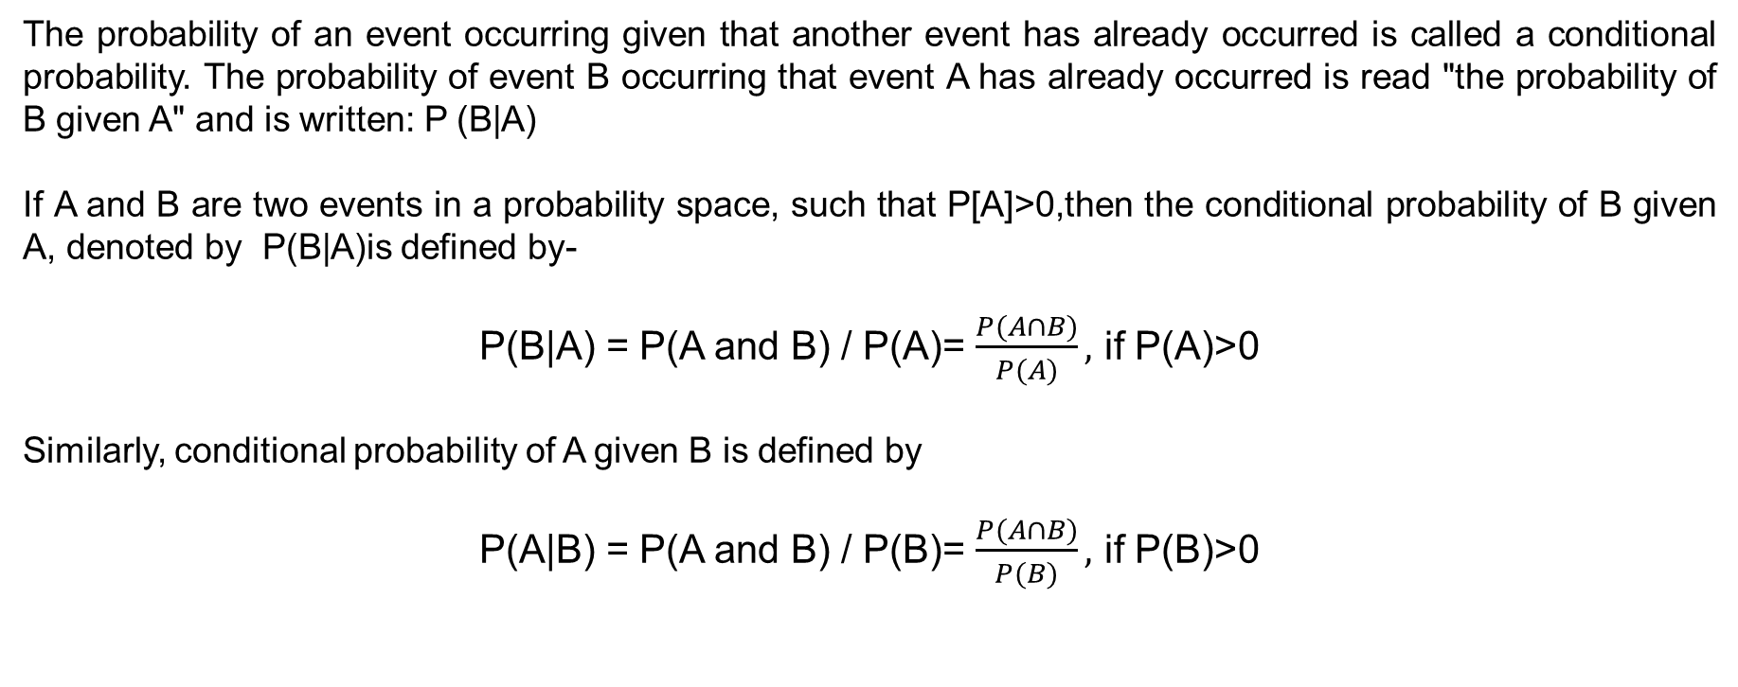
Conditional Probability

Slide 17
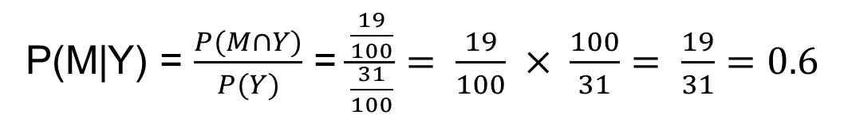
Conditional Probability
Example: The question, "Do you like watching TV?" was asked of 100 people. Results are shown in the table. What is the probability of a randomly selected individual is a male if it is given that he likes watching TV?
 | Yes | No | Total
Male | 19 | 41 | 60
Female | 12 | 28 | 40
Total | 31 | 69 | 100
Solution: The conditional probability M given Y is-

Slide 18
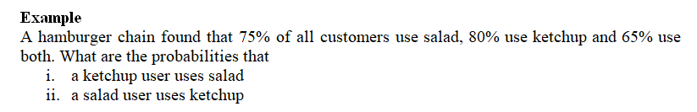
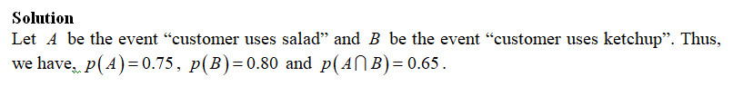




Slide 19
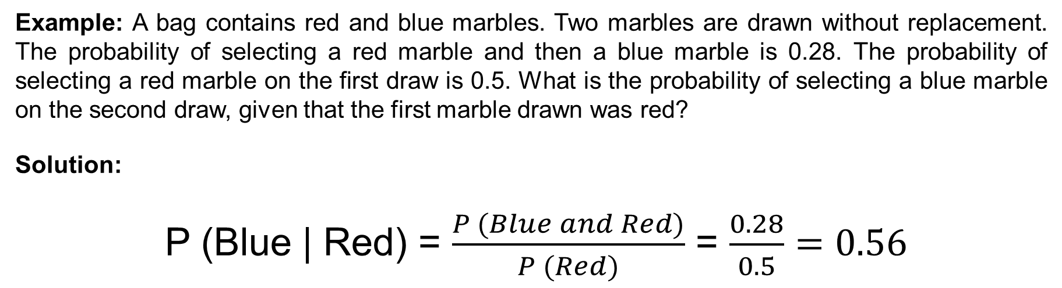
Conditional Probability

Slide 20
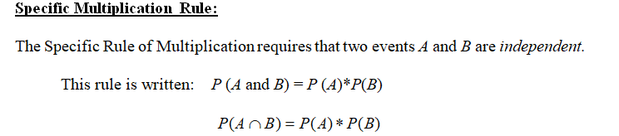
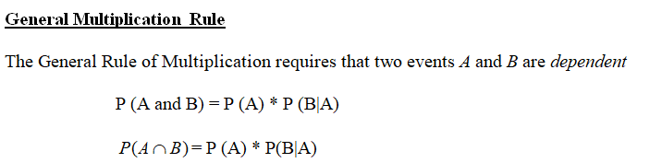
Multiplication Rule

Slide 21
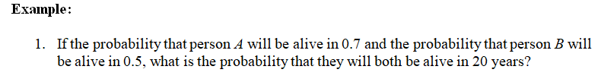
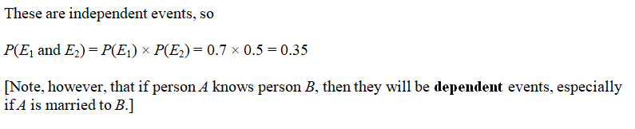
Multiplication Rule

Slide 22
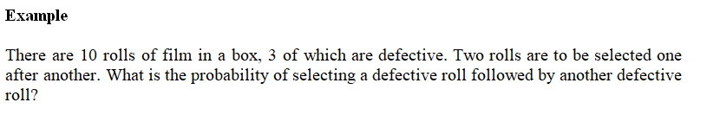
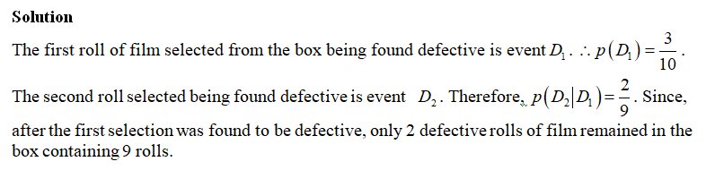
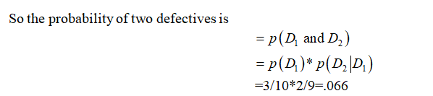

Slide 23
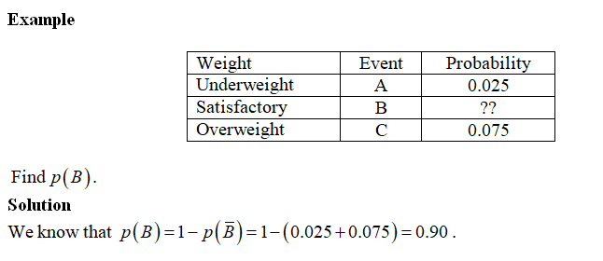
Complement Rule

Slide 25
Chapter Exercise
1. The following table gives a two-way classification of all basketball players at a state university who began their college careers between 2001 and 2005, based on gender and whether or not they graduated.
 | Graduated | Did Not Graduate | Total
Male | 126 | 55 | 181
Female | 133 | 32 | 165
Total | 259 | 87 | 346
If one of these players is selected at random, find the following probabilities.
a. P (female or did not graduate)
b. P (graduated and male)
c. P (Graduated | female)

Slide 26
Chapter Exercise
1.In a class of 120 students, 60 are studying English, 50 are studying French and 20 are studying both English and French. If a student is selected at random from this class, what is the probability that he is studying English if it is given that he is studying French?
2. Jack can hit a target 5 out of 7 chances. Andy can hit a target 6 out of 11.Find the chances that the target is hit once they both try?
3. Russell is playing in a cricket match and a game of football at the weekend. The probability that his team will win the cricket match is 0.7, and the probability of winning is 0.9 in the football. What is the probability that his team will win in both matches? What is the probability that his team will not win in both matches?
4. Suppose you have a box with 3 blue marbles, 2 red marbles, and 4 yellow marbles. You are going to pull out one marble, record its color, put it back in the box and draw another marble. Find the probability that the first marble is red and second marble is yellow.
5. The probability that Mr. X will die in the next 20 years is 1/5 and the probability that Mr. Y will die in the next 20 years is 1/7. What is the probability that
i. Both will die in the next 20 years. ii. At least one will die in the next 20 years. iii. Neither will die in the next 20 years.

Slide 27
Thank You

